Slide 1
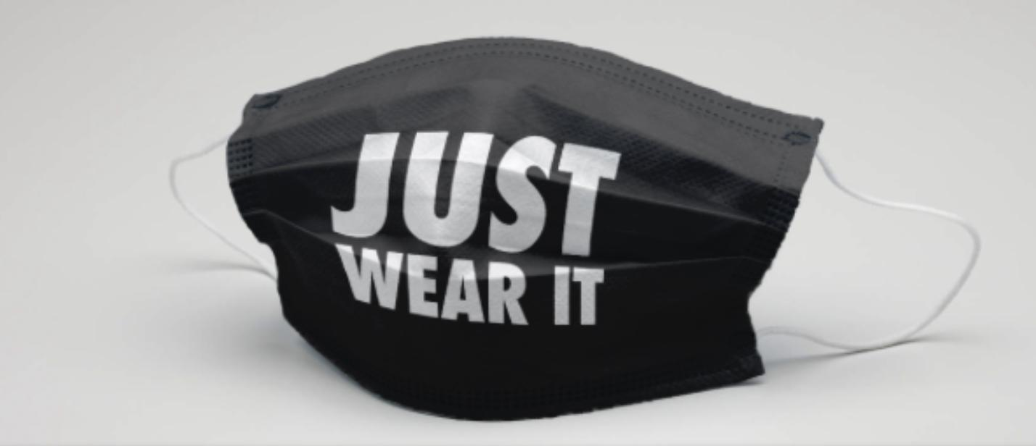
COVID-19 Masks
Designed by Irene Faiz
Media Literacy Key Concepts

Slide 2
The Eight Media Literacy Key Concepts
Media Construct Reality
Media Construct Versions of Reality
Audiences Negotiate Meaning
Media Have Economic Implications
Media Communicate Values Messages
Media Communicate Political and Social Messages
Form and Content Are Closely related in Each Medium
Each Medium Has A Unique Aesthetic Form

Slide 3
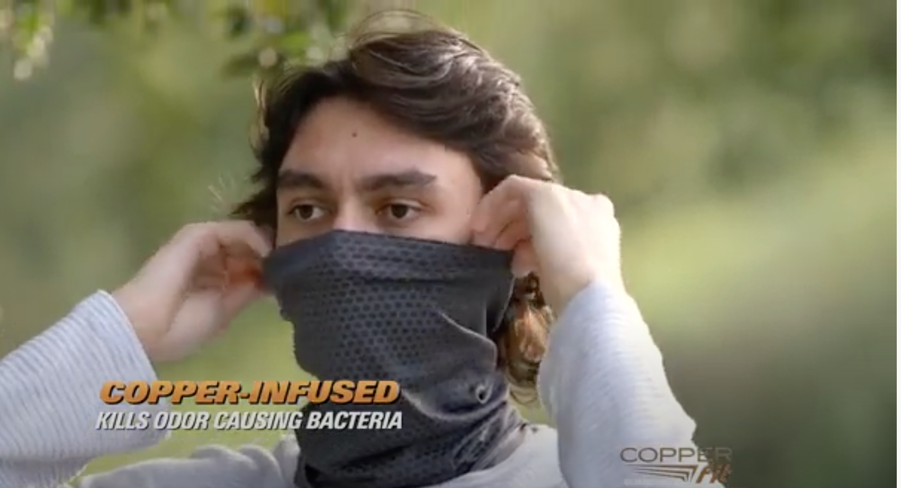
Which Key Concept is this video illustrating?
https://www.youtube.com/watch?v=vm9ckdlDSVE
Media Construct Reality
Media Construct Versions of Reality
Audiences Negotiate Meaning
Media Have Economic Implications
Media Communicate Values Messages
Media Communicate Political and Social Messages
Form and Content Are Closely related in Each Medium
Each Medium Has A Unique Aesthetic Form
The Ultimate Copper-Infused Full Face Protector

Slide 4
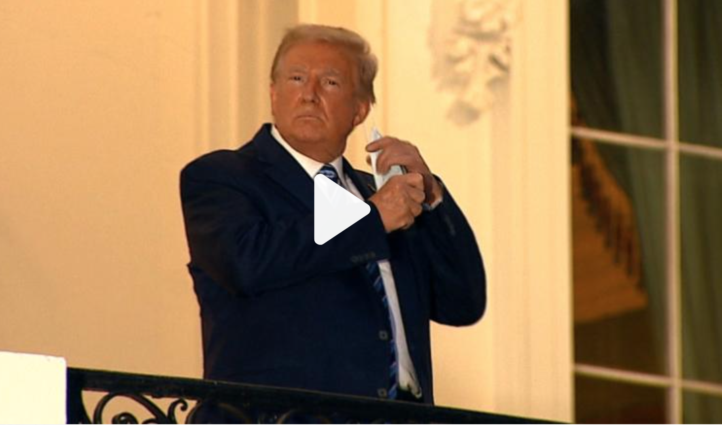
Which Key Concept is this video illustrating?
https://www.cnn.com/2020/10/06/politics/donald-trump-coronavirus-white-house-biden/index.html
Media Construct Reality
Media Construct Versions of Reality
Audiences Negotiate Meaning
Media Have Economic Implications
Media Communicate Values Messages
Media Communicate Political and Social Messages
Form and Content Are Closely related in Each Medium
Each Medium Has A Unique Aesthetic Form

Slide 5
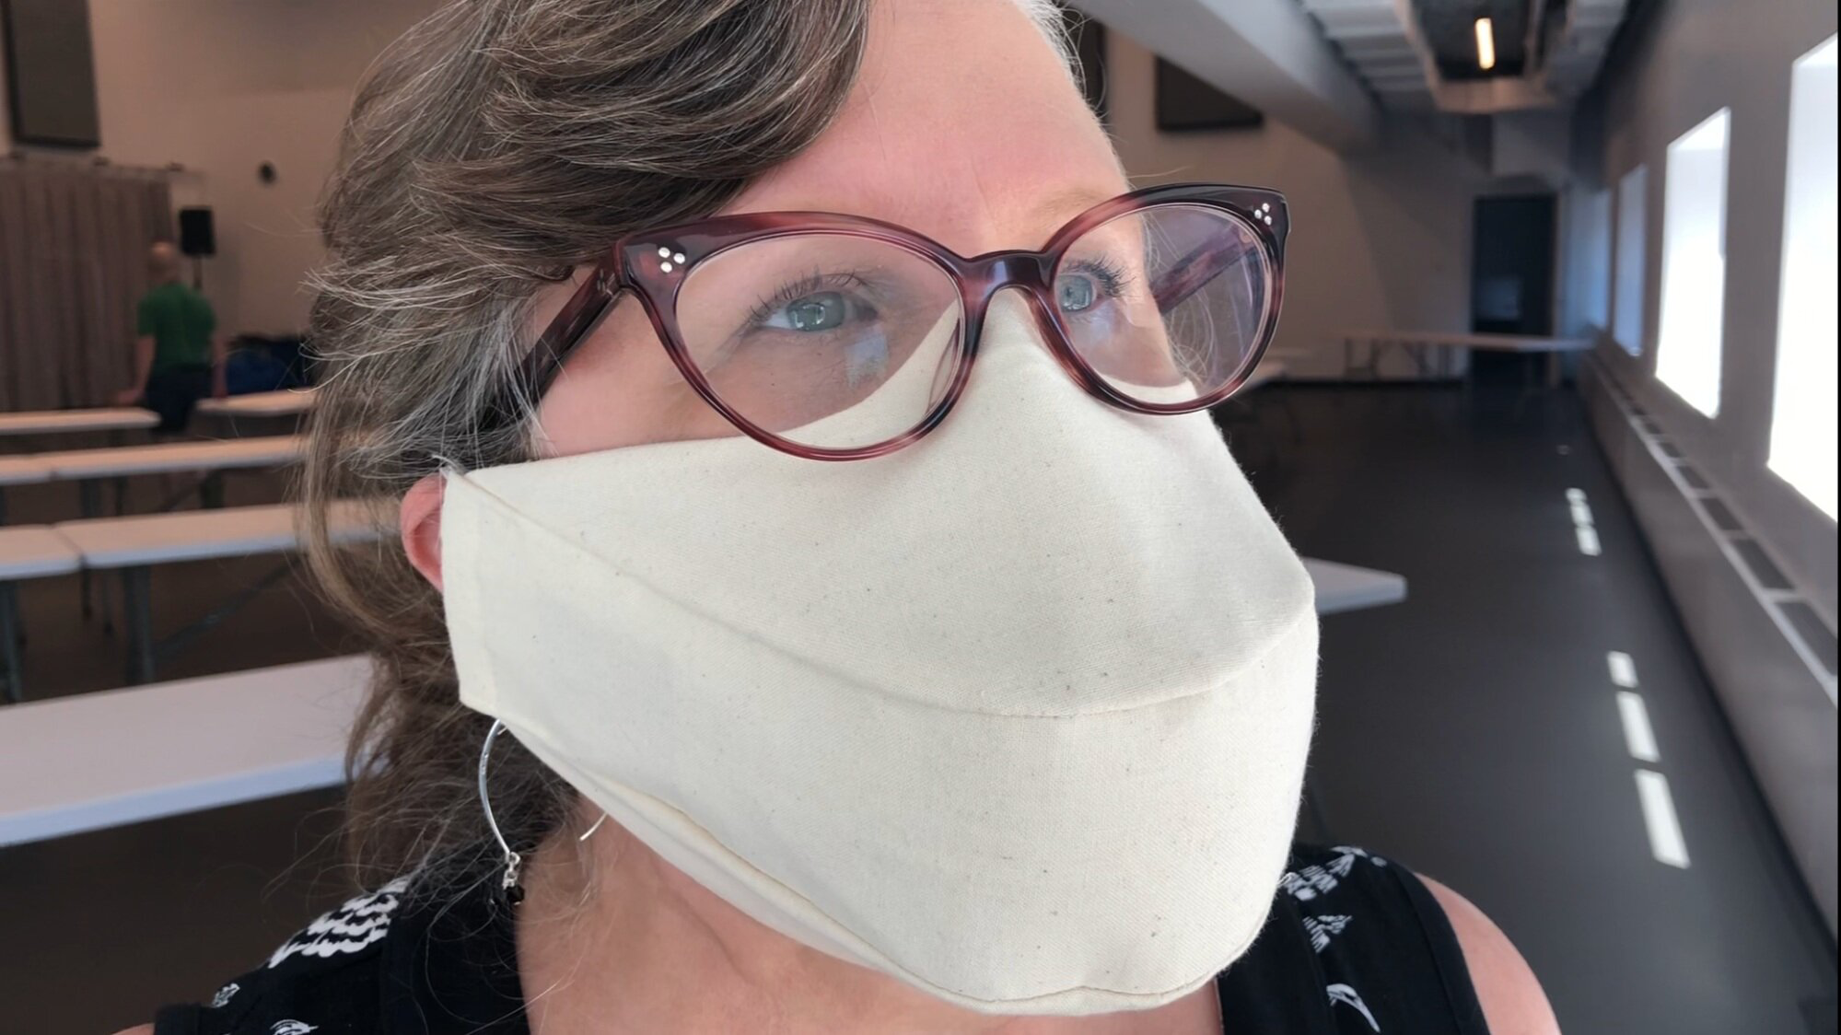
Which Key Concept is this video illustrating?
https://www.youtube.com/watch?v=qt33F9H9BkQ&feature=youtu.be
This mask has been designed for singers.
Media Construct Reality
Media Construct Versions of Reality
Audiences Negotiate Meaning
Media Have Economic Implications
Media Communicate Values Messages
Media Communicate Political and Social Messages
Form and Content Are Closely related in Each Medium
Each Medium Has A Unique Aesthetic Form

Slide 6
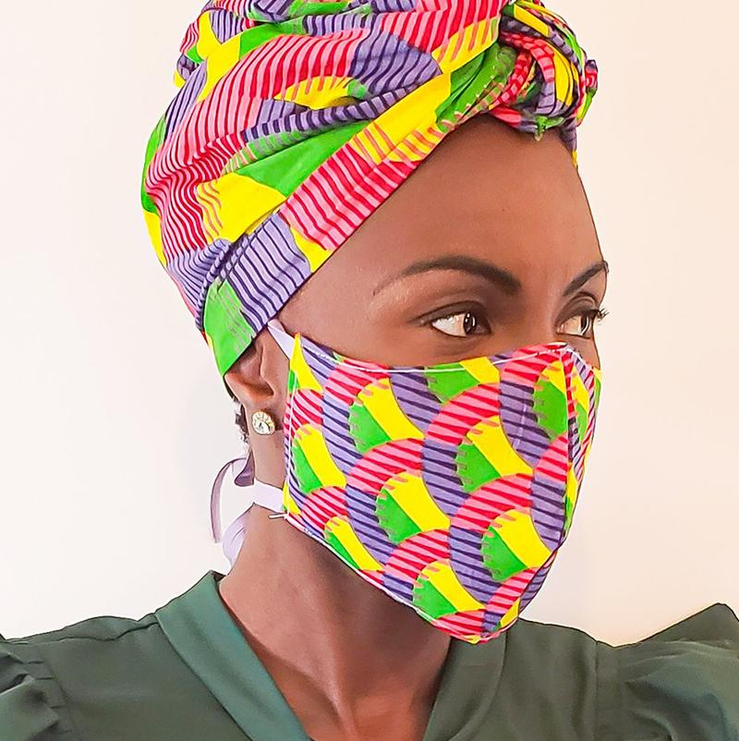
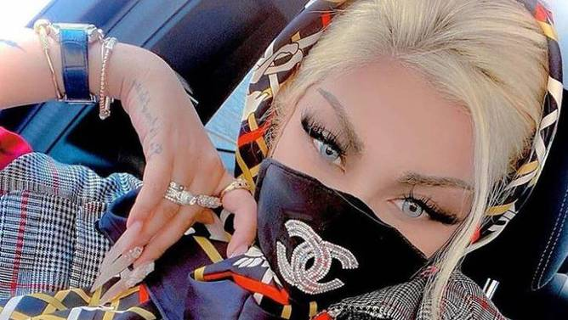
Which Key Concept are these COVID-19 Masks illustrating?
Media Construct Reality
Media Construct Versions of Reality
Audiences Negotiate Meaning
Media Have Economic Implications
Media Communicate Values Messages
Media Communicate Political and Social Messages
Form and Content Are Closely related in Each Medium
Each Medium Has A Unique Aesthetic Form

Slide 7
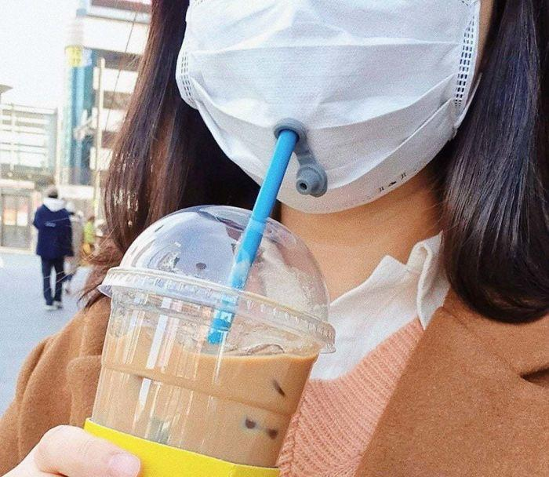
Which Key Concept is the COVID-19 Mask illustrating?
Media Construct Reality
Media Construct Versions of Reality
Audiences Negotiate Meaning
Media Have Economic Implications
Media Communicate Values Messages
Media Communicate Political and Social Messages
Form and Content Are Closely related in Each Medium
Each Medium Has A Unique Aesthetic Form

Slide 8
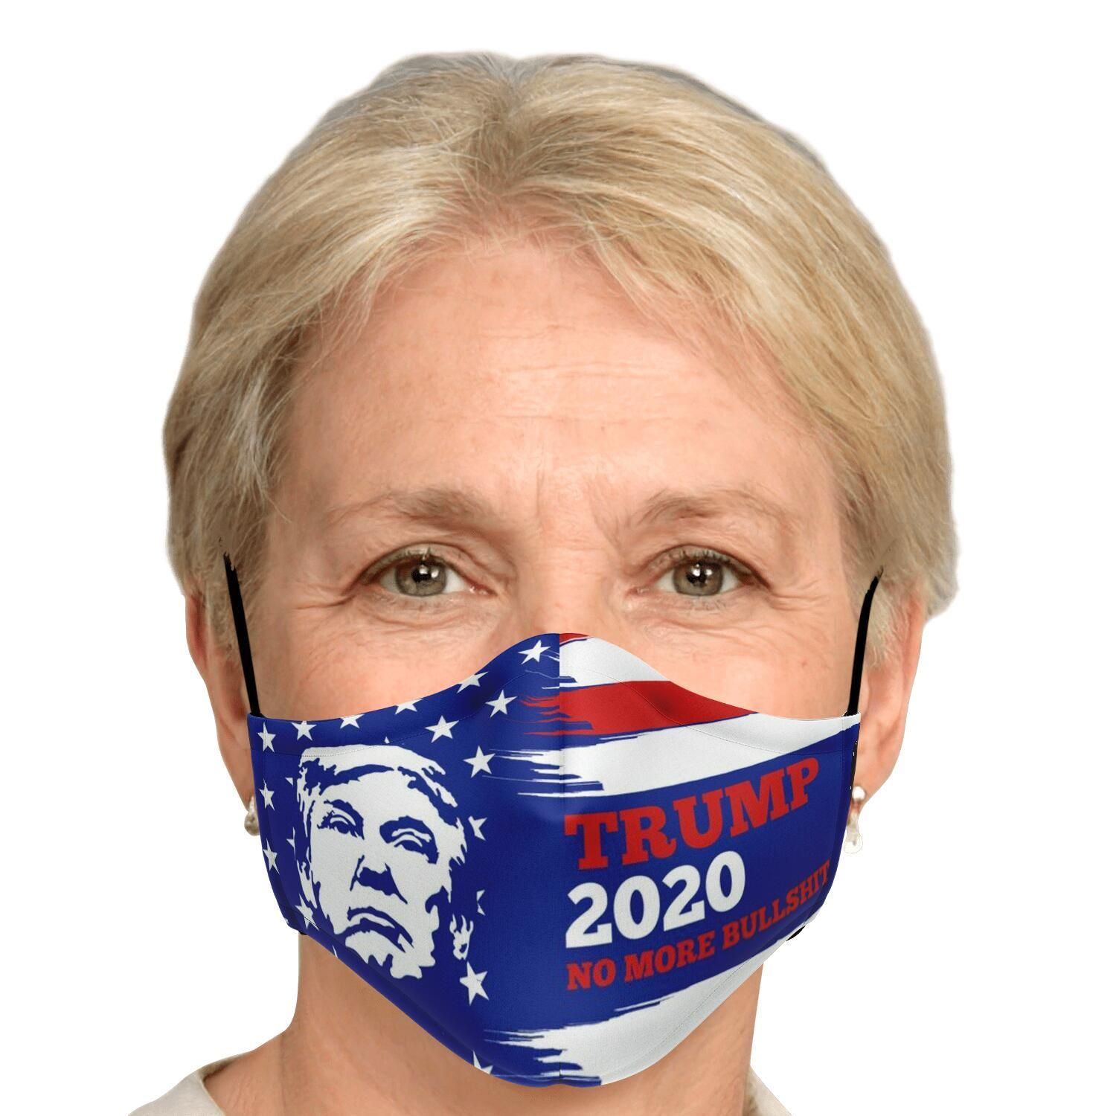
Which Key Concept are these COVID-19 Masks illustrating?
Media Construct Reality
Media Construct Versions of Reality
Audiences Negotiate Meaning
Media Have Economic Implications
Media Communicate Values Messages
Media Communicate Political and Social Messages
Form and Content Are Closely related in Each Medium
Each Medium Has A Unique Aesthetic Form

Slide 9
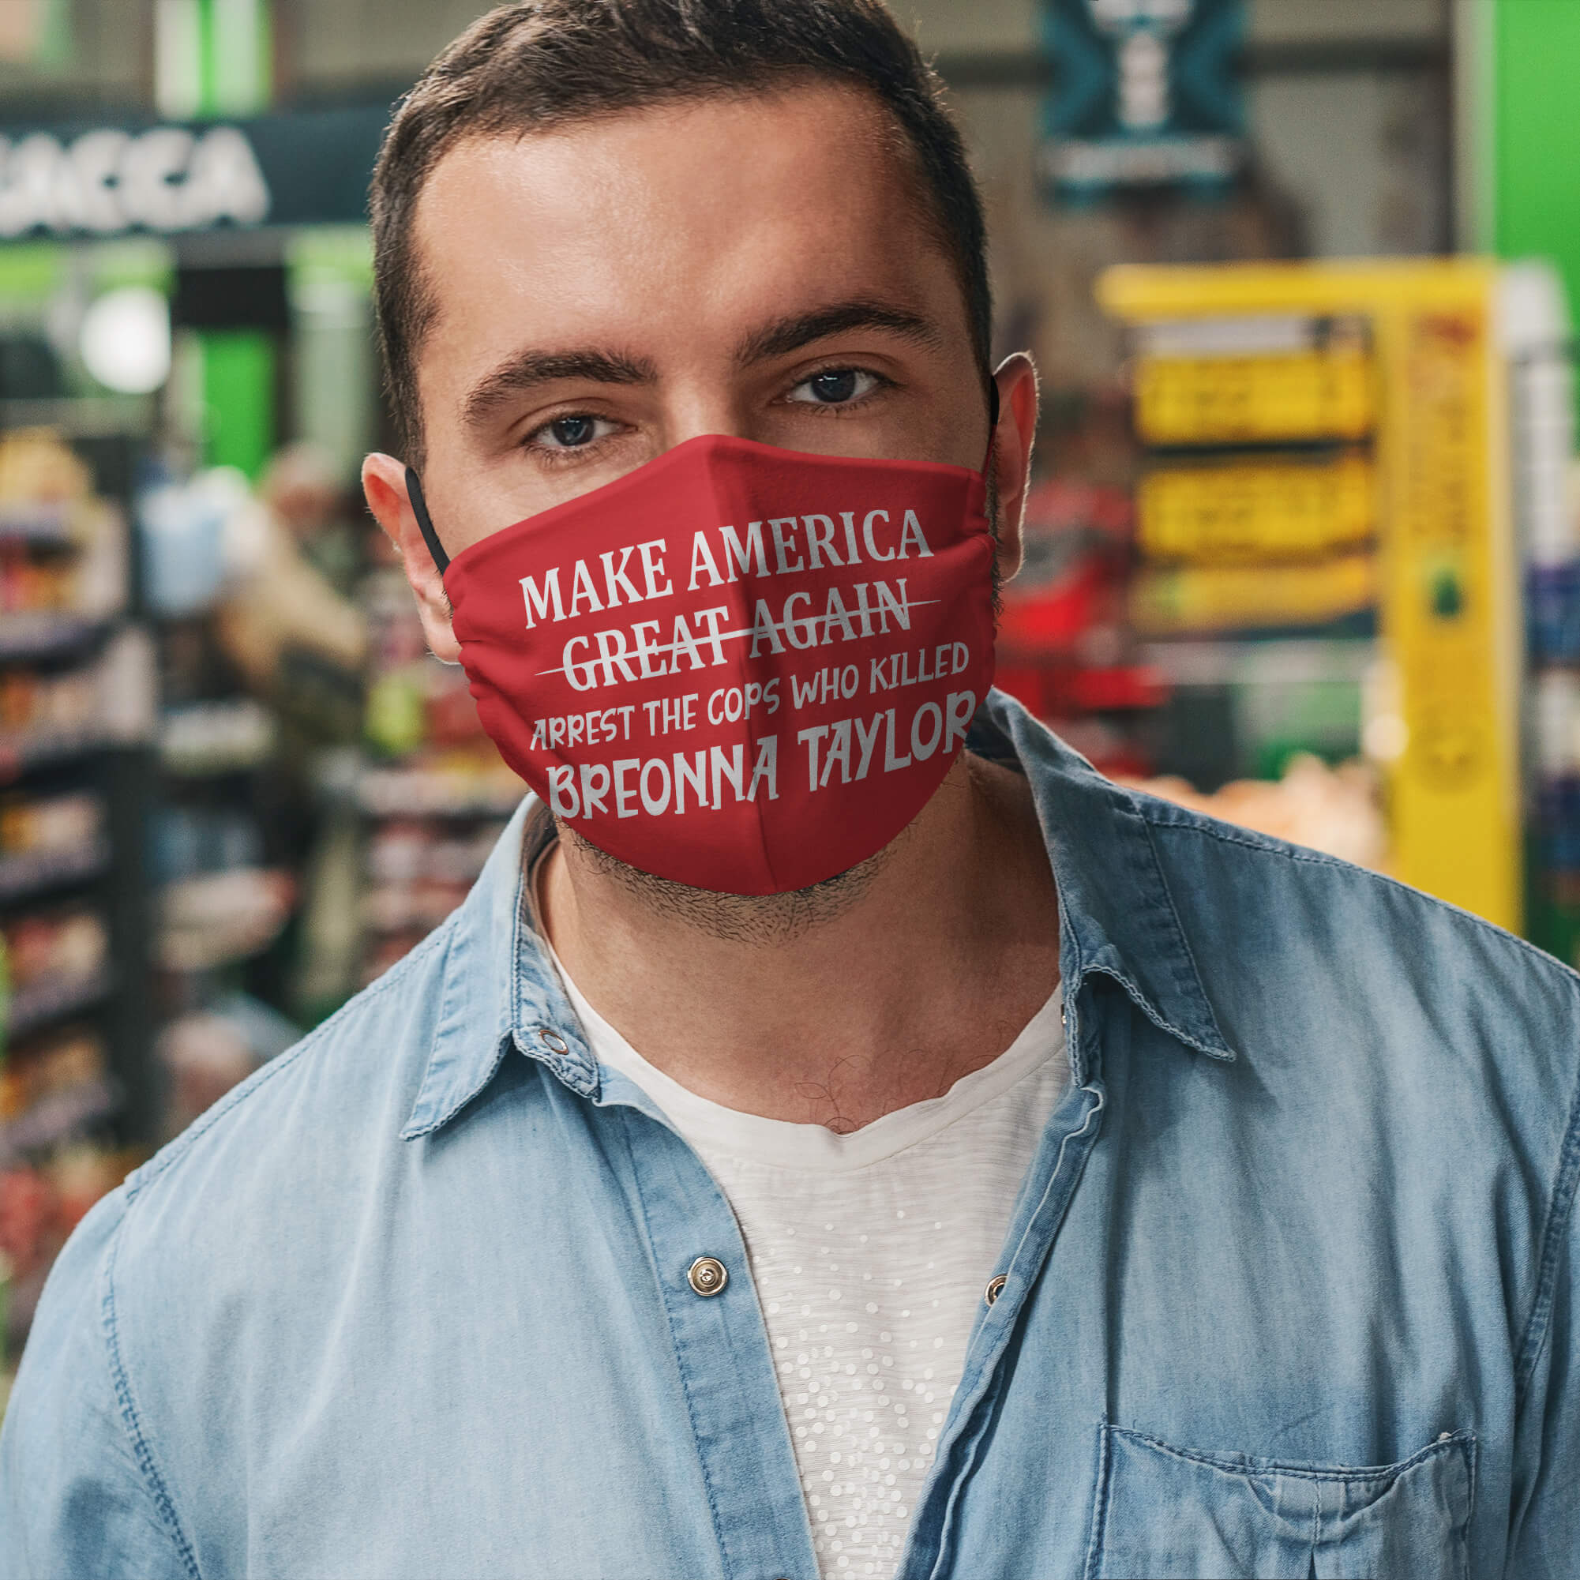
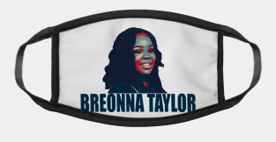
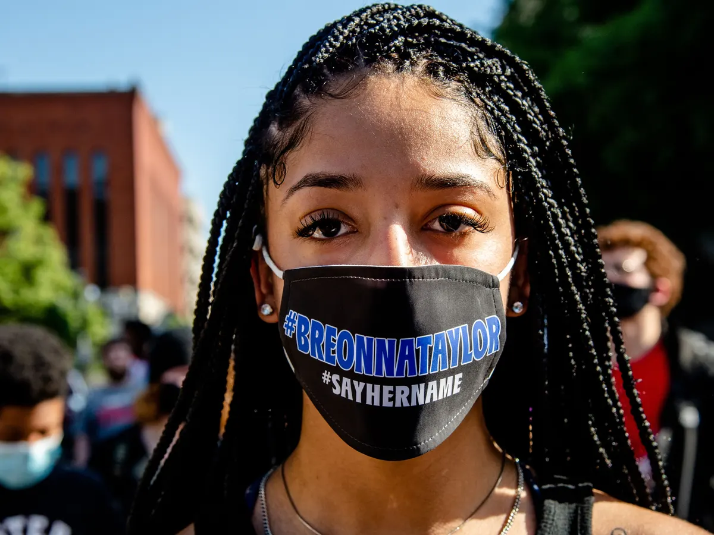
Which Key Concept are these COVID-19 Masks illustrating?
Media Construct Reality
Media Construct Versions of Reality
Audiences Negotiate Meaning
Media Have Economic Implications
Media Communicate Values Messages
Media Communicate Political and Social Messages
Form and Content Are Closely related in Each Medium
Each Medium Has A Unique Aesthetic Form

Slide 10
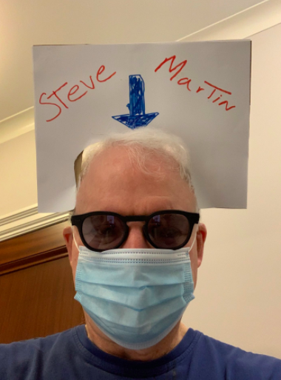
Which Key Concept is this COVID-19 Mask illustrating?
Media Construct Reality
Media Construct Versions of Reality
Audiences Negotiate Meaning
Media Have Economic Implications
Media Communicate Values Messages
Media Communicate Political and Social Messages
Form and Content Are Closely related in Each Medium
Each Medium Has A Unique Aesthetic Form

